Slide 1


Legend Charity Football Match TH
C Programming Project
Create by
Narawut Rojnirunchai
6304062660021

Slide 2
What is the Legend Charity football match TH about?
25 Sat. Sep 2021 6:00 PM
About Buriram United Legend VS Muangthong United Saturday 6 p.m
26 Sun. Sep 2021 6:00 PM
Buriram United VS Muangthong United Sunday 6 p.m
18 Sat. Sep 2021 6:00 PM
About Thailand Legend VS Manchester United Legend on Saturday. 6 p.m
19 Sun. Sep 2021 6:00 PM
Thailand VS Manchester United on Sunday. 6 p.m

Slide 3
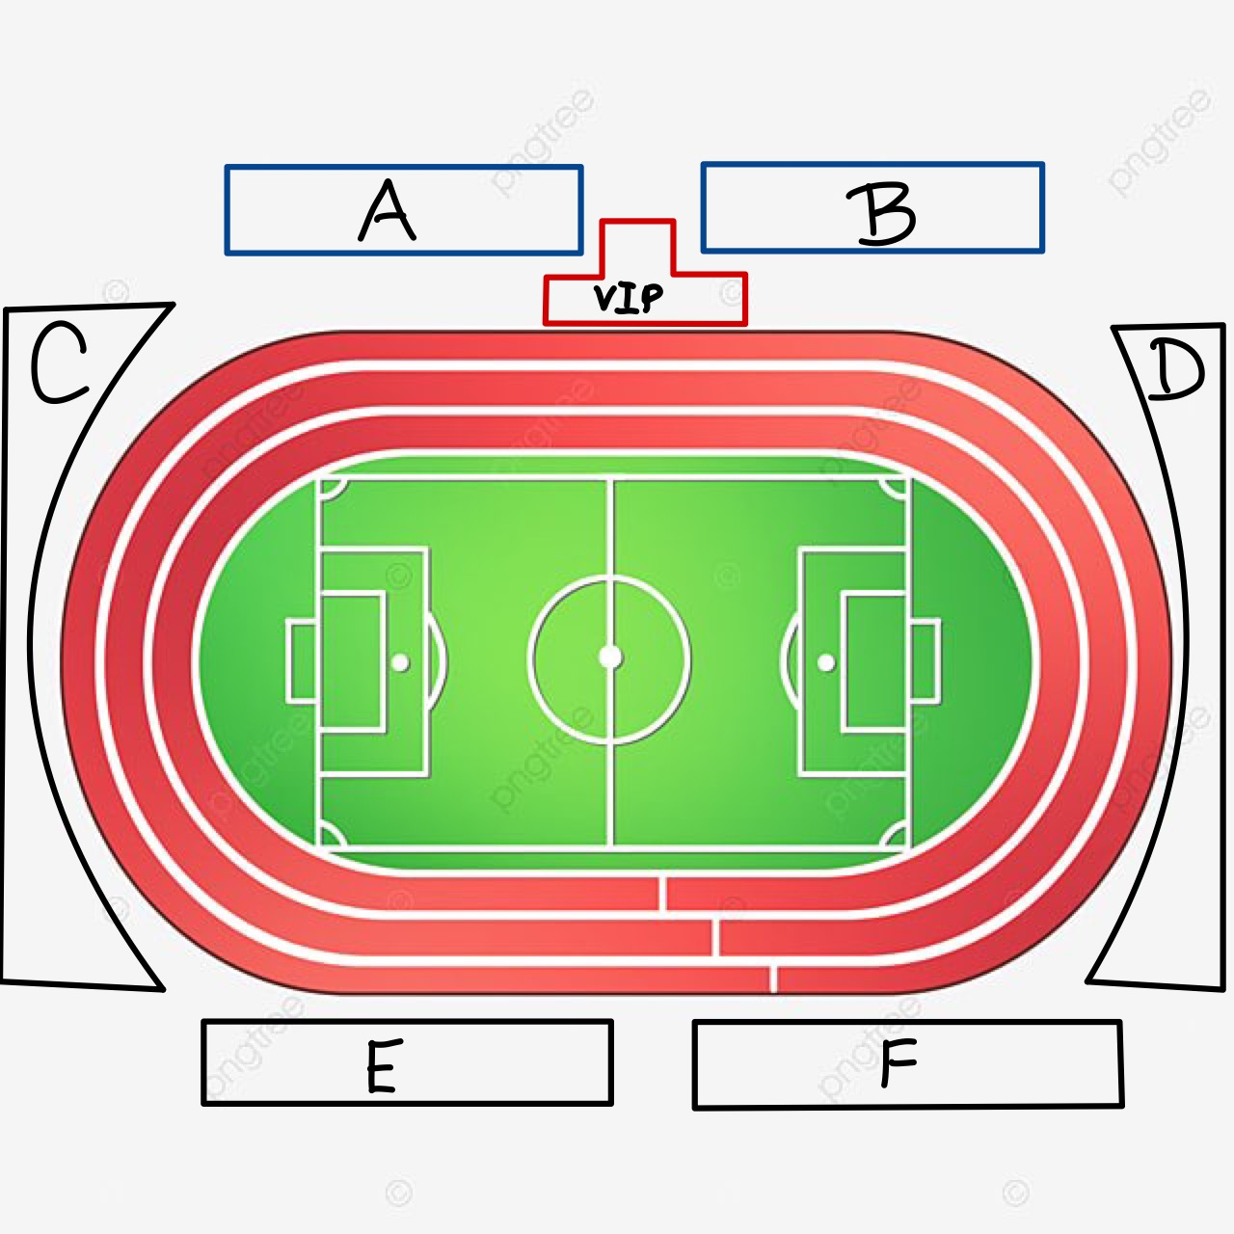
5,804 seat
ROOF
Total capacity of Suphachalasai stadium to 20,000 seats.
Price
Zone VIP 4000 Baht
Zone A 500 Baht
Zone B 500 Baht
Zone C 300 Baht
Zone D 300 Baht
Zone E 300 Baht
Zone F 300 Baht
4,383 seats
3,942 seats
5,486 seats

Slide 4
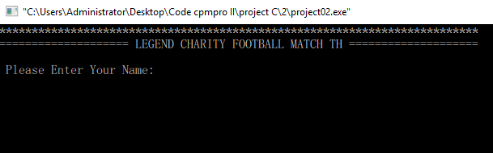
About Program

Slide 5
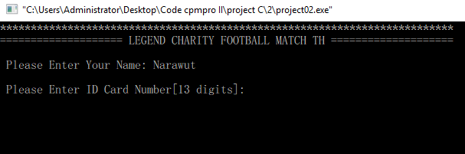
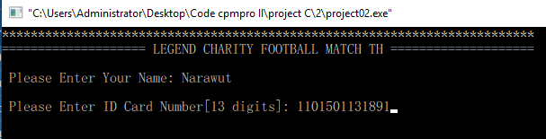

Slide 6
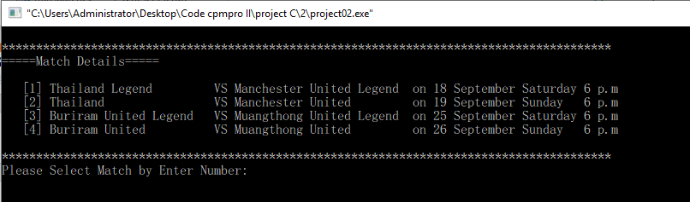
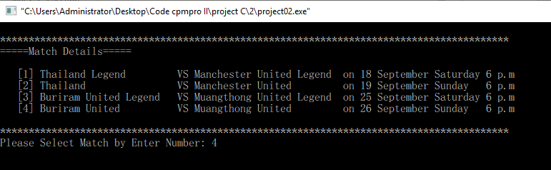
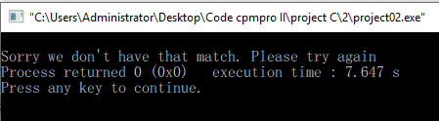

Slide 7
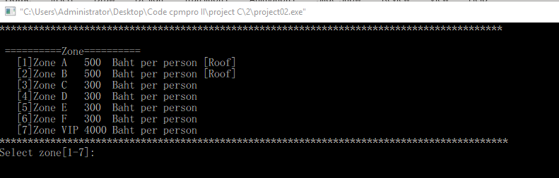
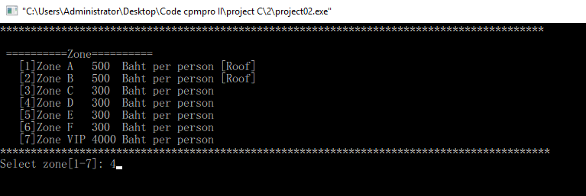
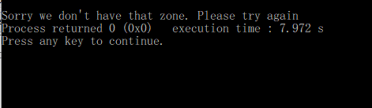

Slide 8
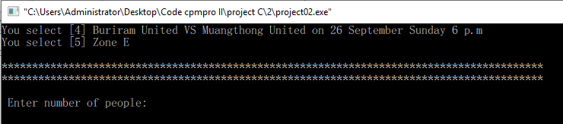
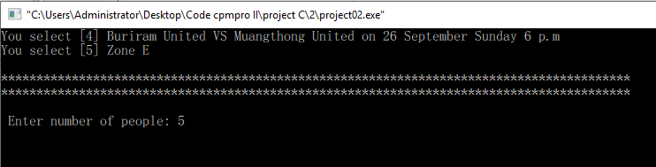
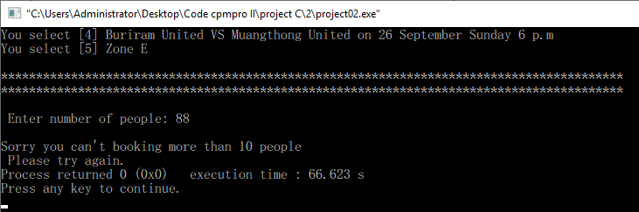

Slide 9
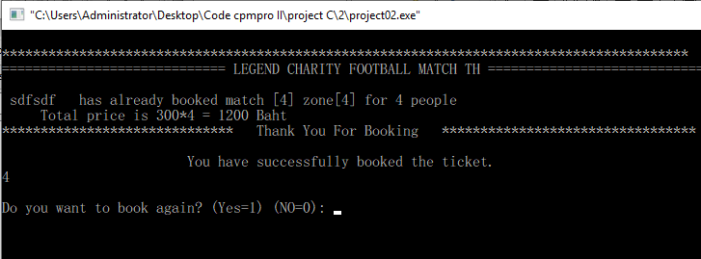

Slide 10
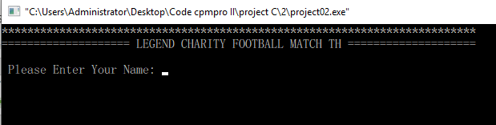

Slide 11
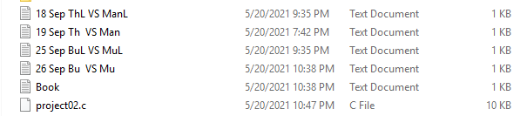
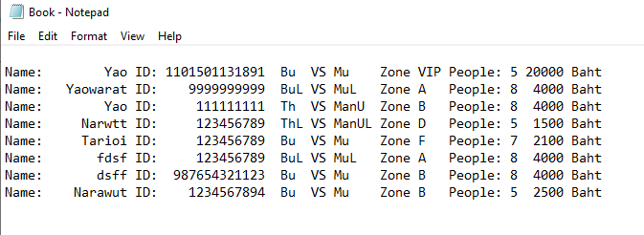
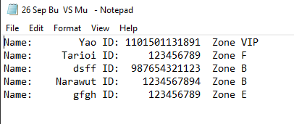
DATA File

Slide 12

The Problem of this program
-This program can only save data file.
-Cannot tell how many seat left.
-Cannot check Name and ID number.

Slide 13


